Slide 1
Introduction to Deep Learning

Slide 2
Agenda
Machine Learning vs Deep Learning
How ML and DL Works
DL Models
Logistic Regression
Single NN Unit
Activation Functions
Loss Functions
Gradient Descent
Backpropagation
Regularization
CNN
DL Applications

Slide 3
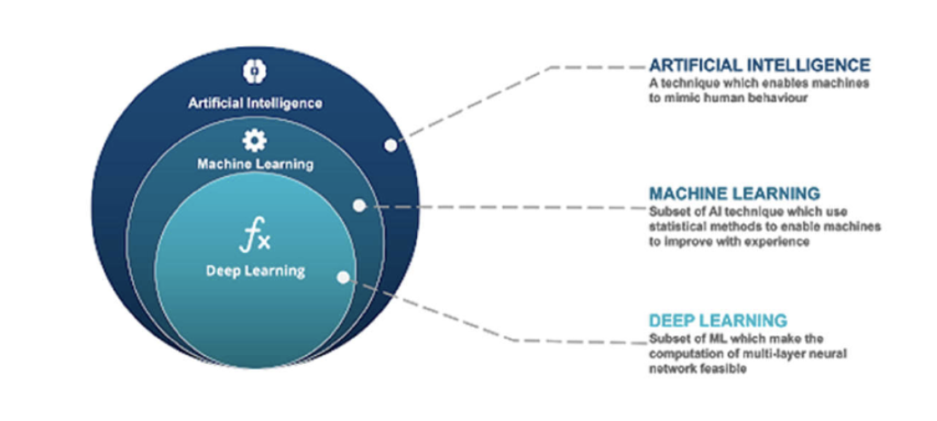
Machine Learning vs Deep Learning

Slide 4
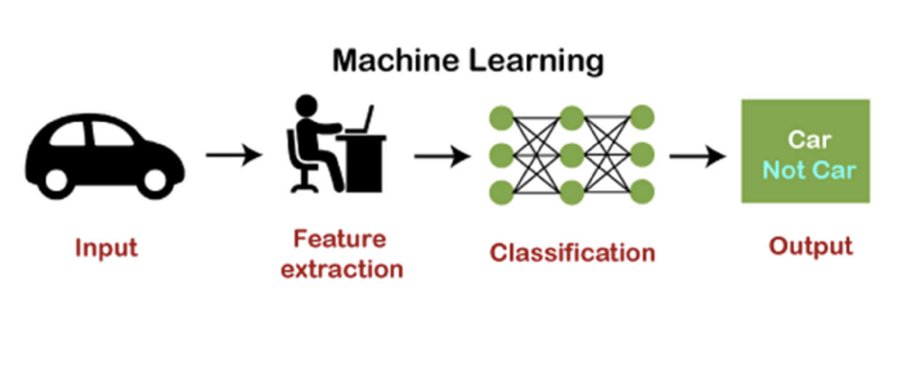
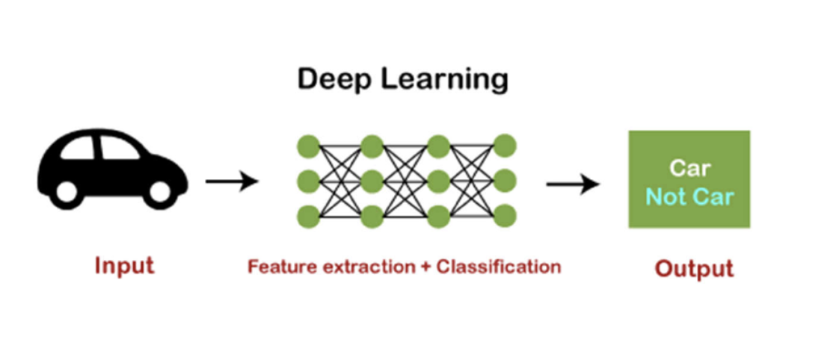
How ML & DL Works

Slide 5
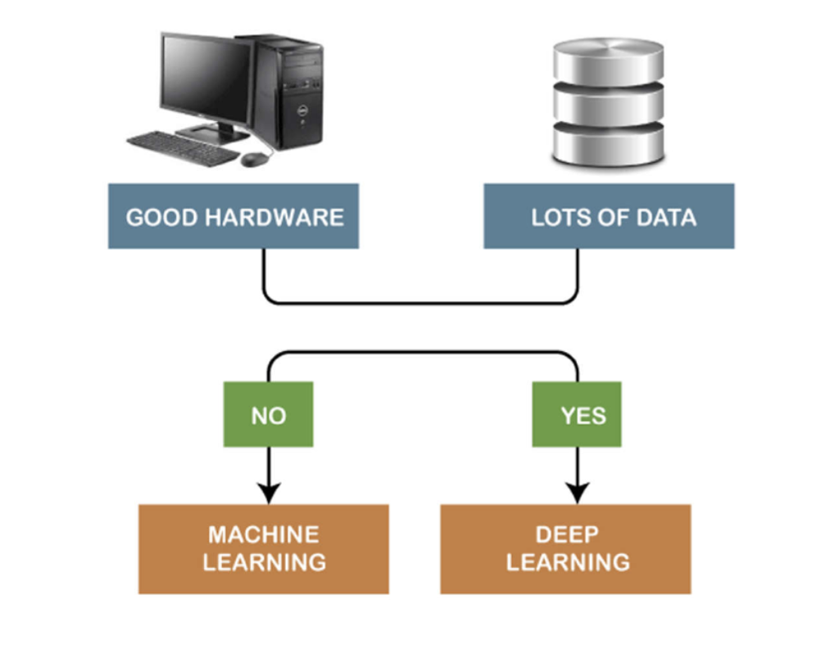
ML or DL

Slide 6
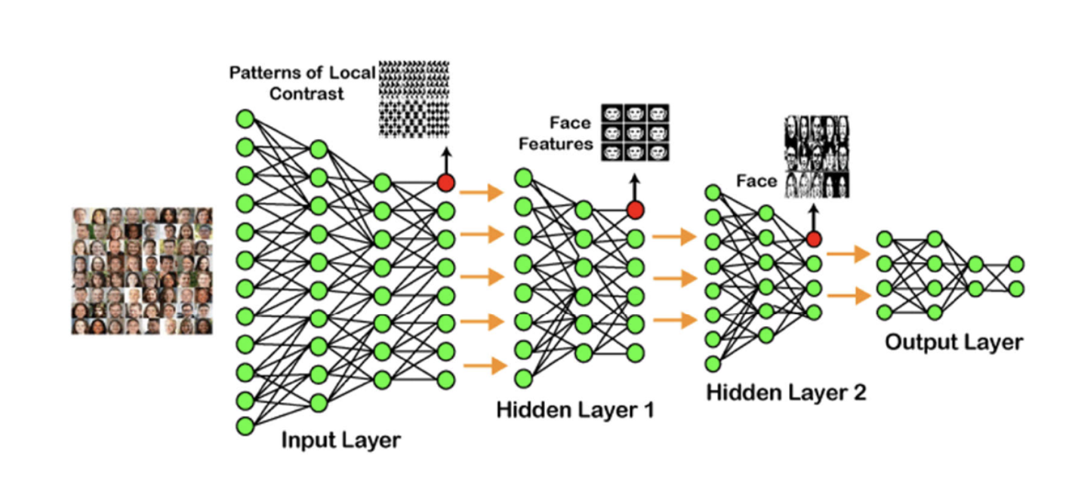
Example of DL
Shallow NN
Deep NN

Slide 7
DL Models
Convolutional Neural Networks (CNN)
Recurrent Neural Networks (RNN)
Autoencoders
Classical Neural Networks, etc.

Slide 8
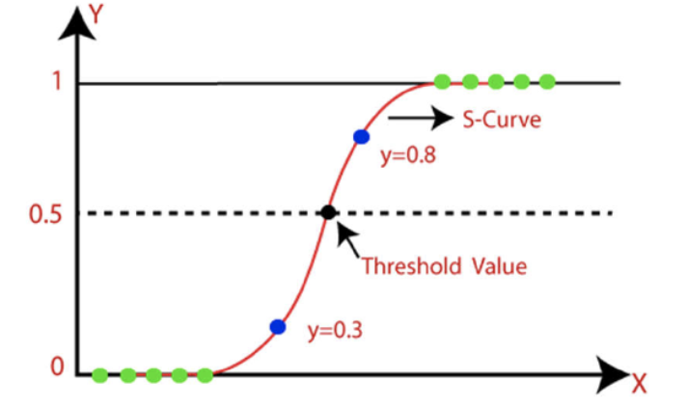
Logistic Regression

Slide 9
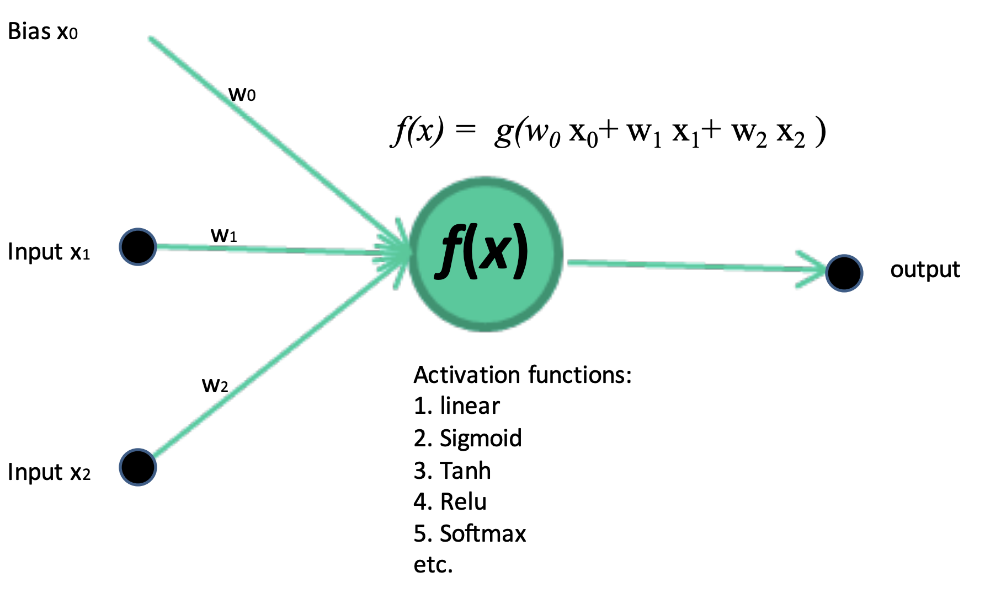
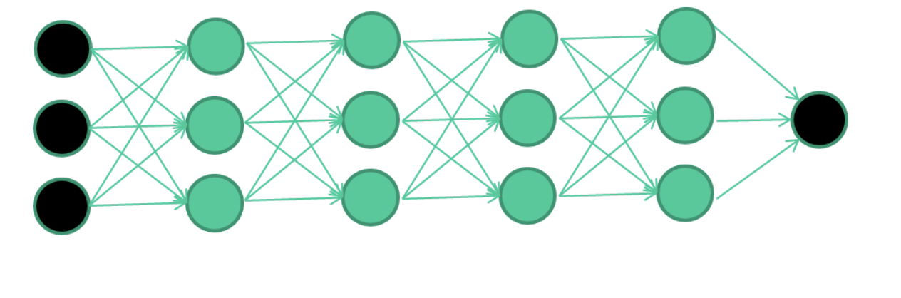
Single NN Unit

Slide 10
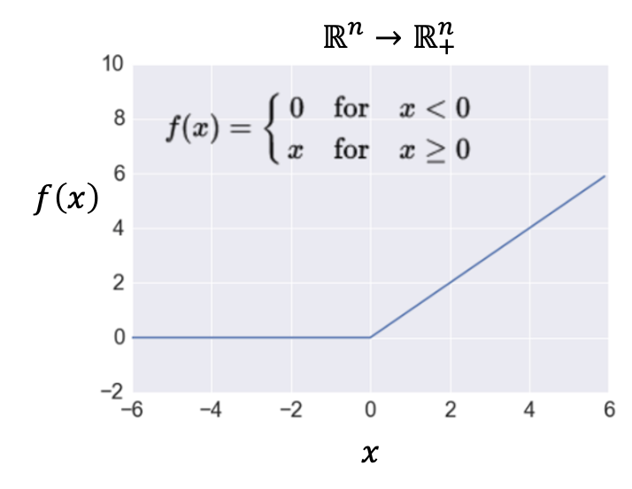
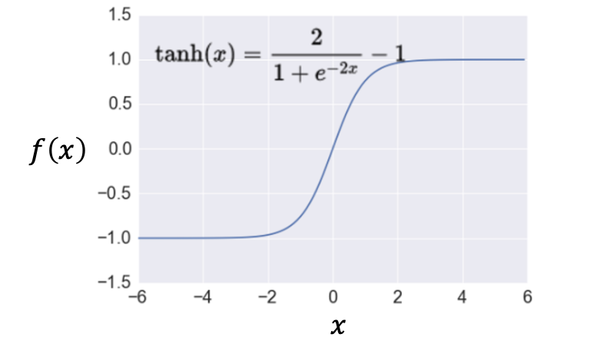
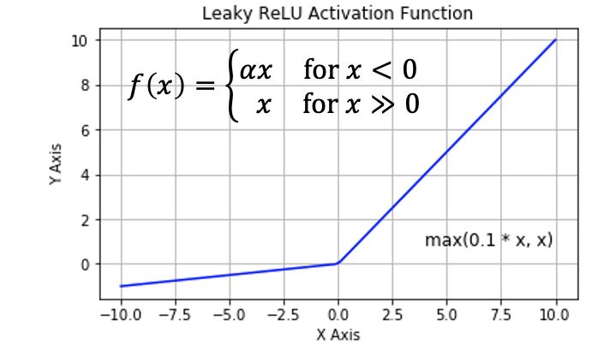
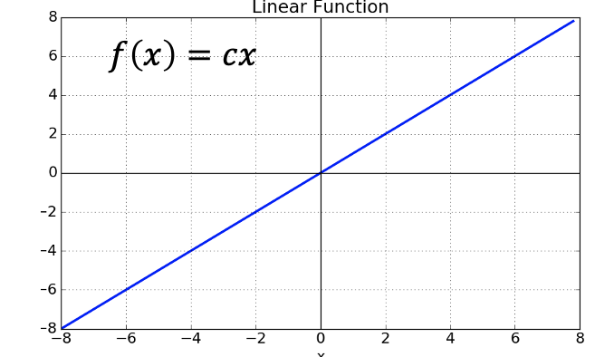
Activation Functions

Slide 11
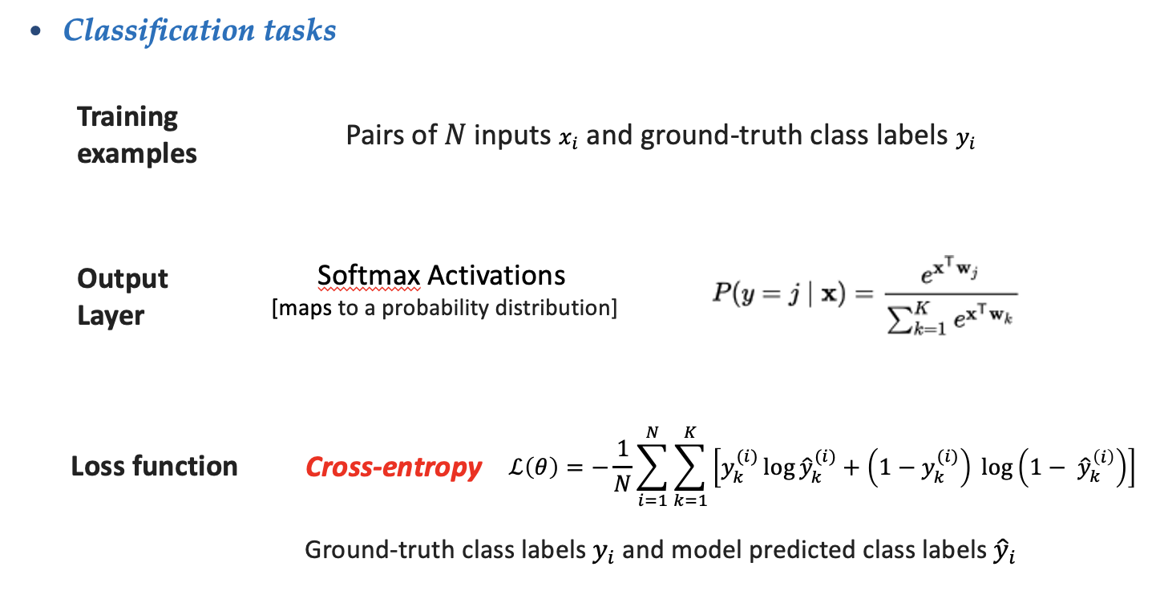
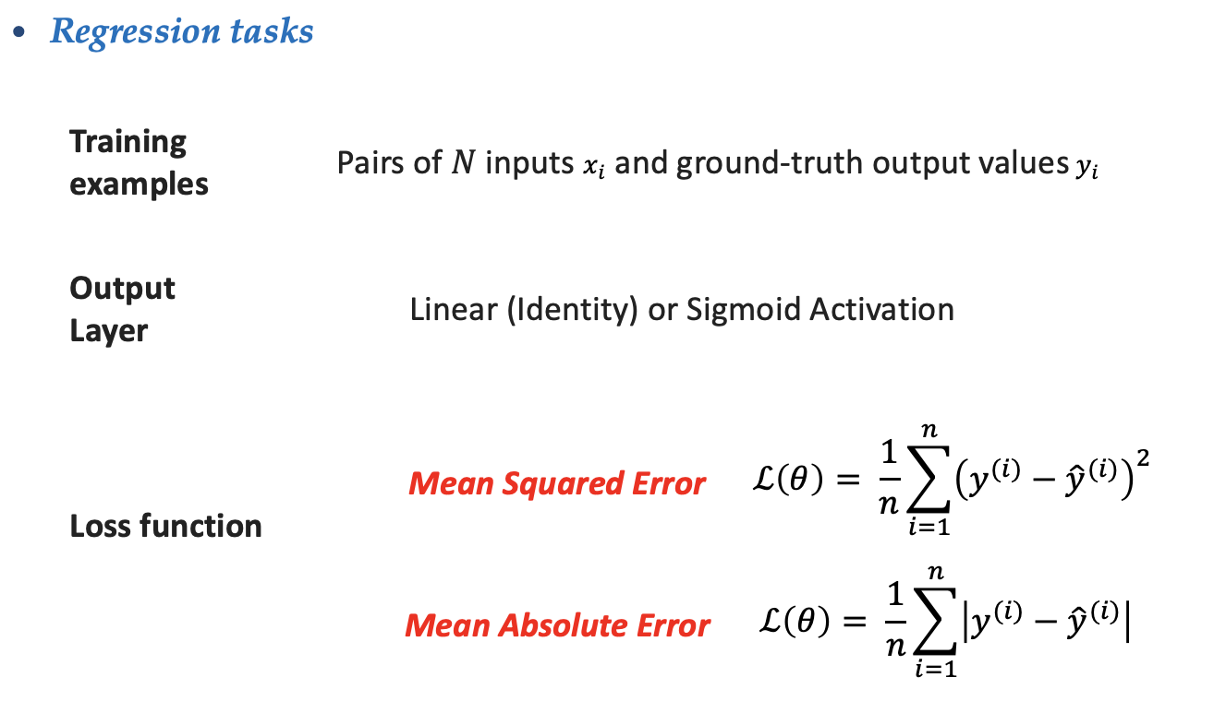
Loss Function

Slide 12
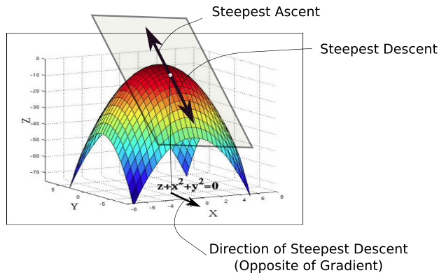
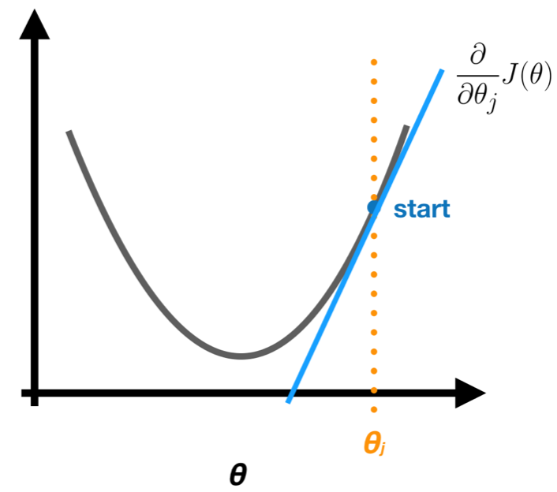
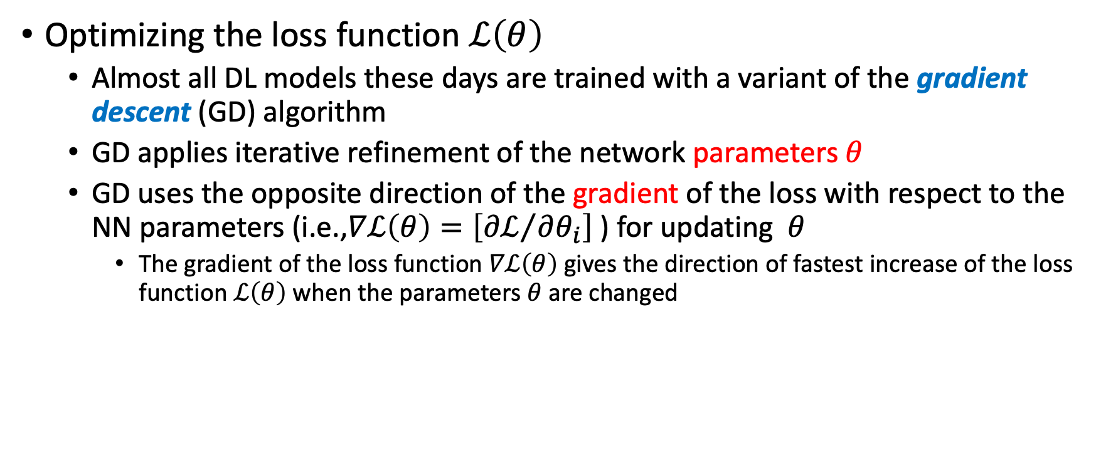
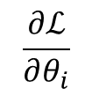
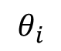
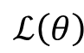
Gradient Descent
Optimizing the loss function $ℒ\left(θ\right)$
Almost all DL models these days are trained with a variant of the gradient descent (GD) algorithm
GD applies iterative refinement of the network parameters$θ$
GD uses the opposite direction of the gradient of the loss with respect to the NN parameters (i.e.,$∇ℒ\left(θ\right)=\left[{∂ℒ}/{∂θ_{i}}\right]$ ) for updating $θ$
The gradient of the loss function $∇ℒ\left(θ\right)$ gives the direction of fastest increase of the loss function $ℒ\left(θ\right)$ when the parameters$θ$ are changed
$$ℒ\left(θ\right)$$
$$\frac{∂ℒ}{∂θ_{i}}$$
$$θ_{i}$$

Slide 13
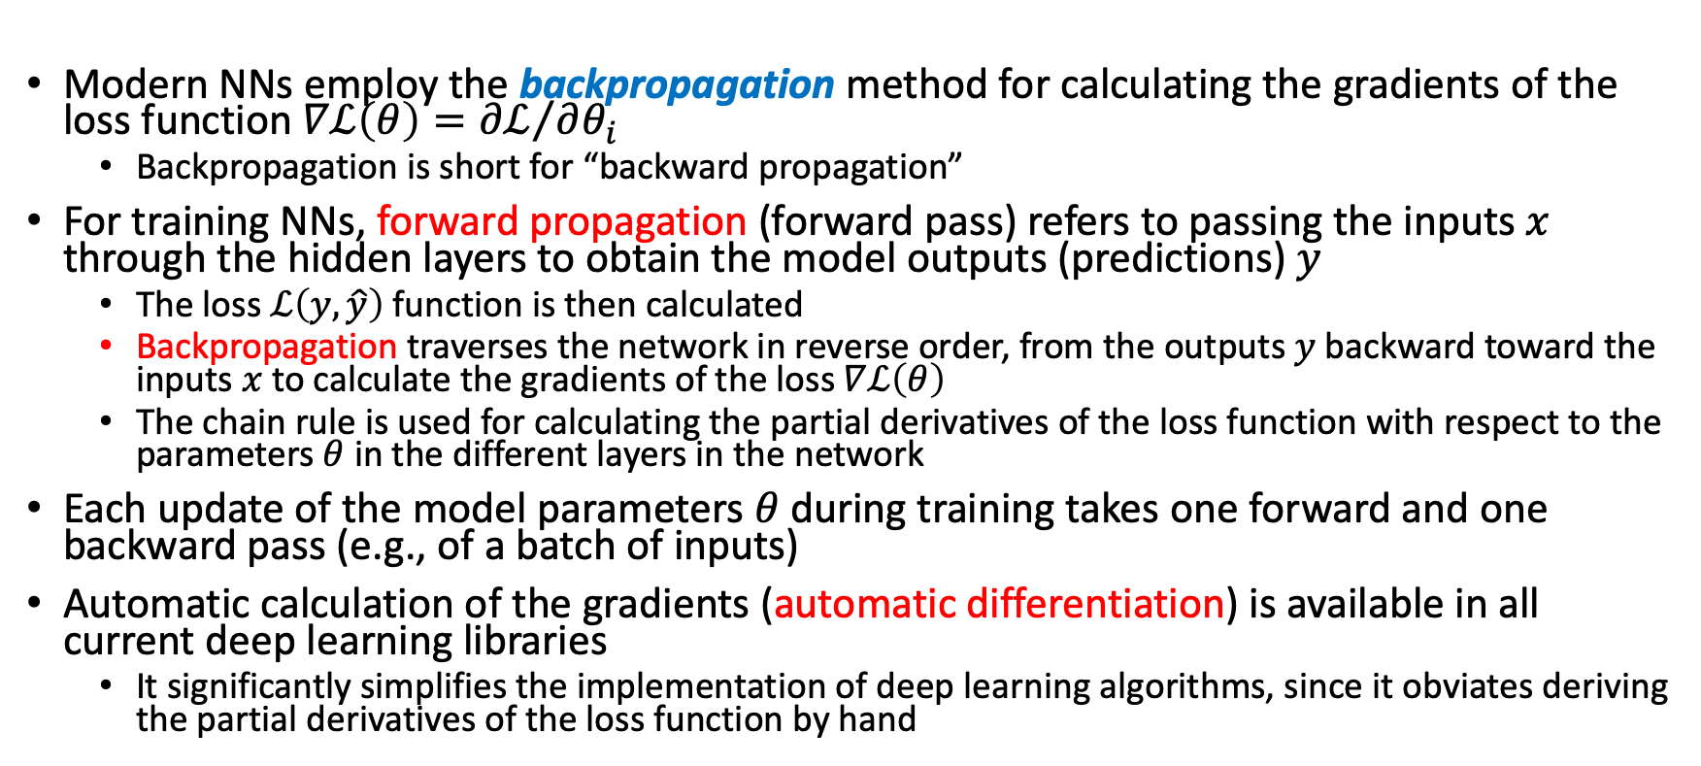
Backpropagaton
Modern NNs employ the backpropagation method for calculating the gradients of the loss function $∇ℒ\left(θ\right)={∂ℒ}/{∂θ_{i}}$
Backpropagation is short for “backward propagation”
For training NNs, forward propagation (forward pass) refers to passing the inputs $x$ through the hidden layers to obtain the model outputs (predictions) $y$
The loss $ℒ\left(y,\hat{y}\right)$ function is then calculated
Backpropagation traverses the network in reverse order, from the outputs $y$ backward toward the inputs $x$ to calculate the gradients of the loss$∇ℒ\left(θ\right)$
The chain rule is used for calculating the partial derivatives of the loss function with respect to the parameters$θ$ in the different layers in the network
Each update of the model parameters $θ$ during training takes one forward and one backward pass (e.g., of a batch of inputs)
Automatic calculation of the gradients (automatic differentiation) is available in all current deep learning libraries
It significantly simplifies the implementation of deep learning algorithms, since it obviates deriving the partial derivatives of the loss function by hand

Slide 14
Regularization
Dropout
Early Stopping
Ridge Regression
Lasso Regression

Slide 15
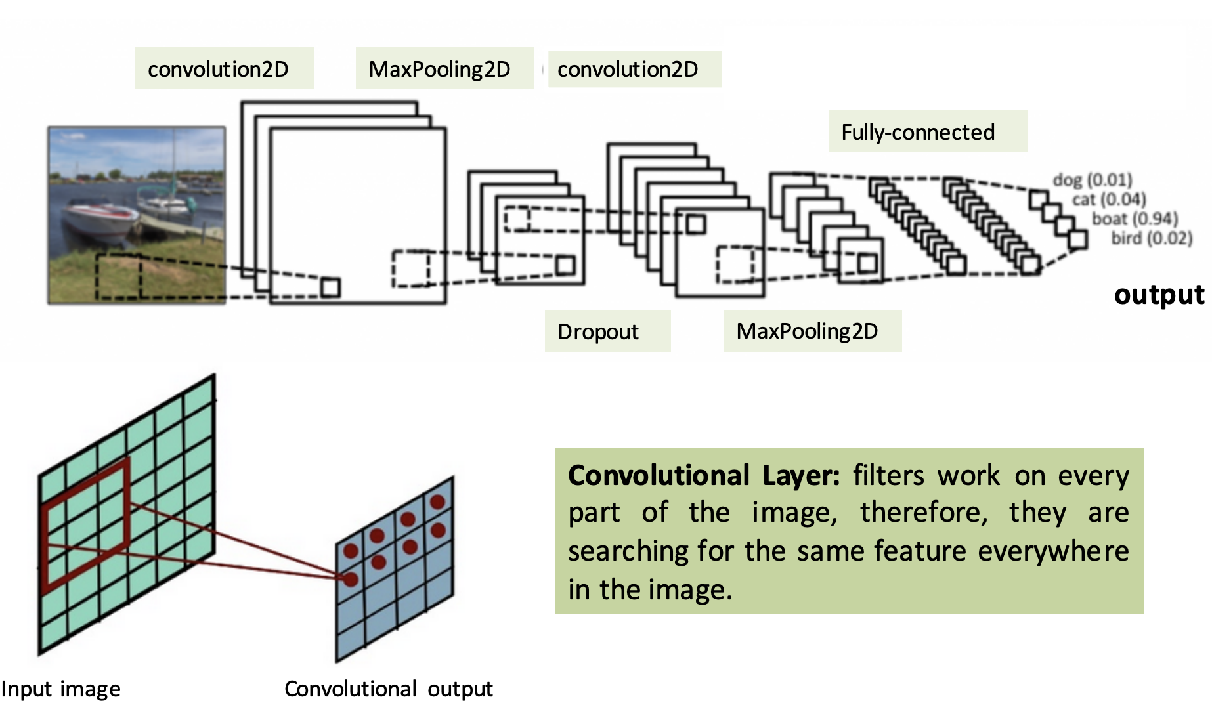
CNN

Slide 16
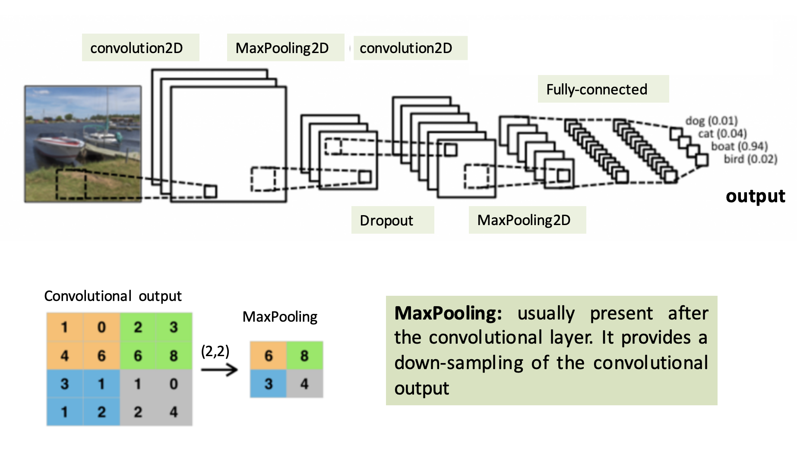

Slide 17
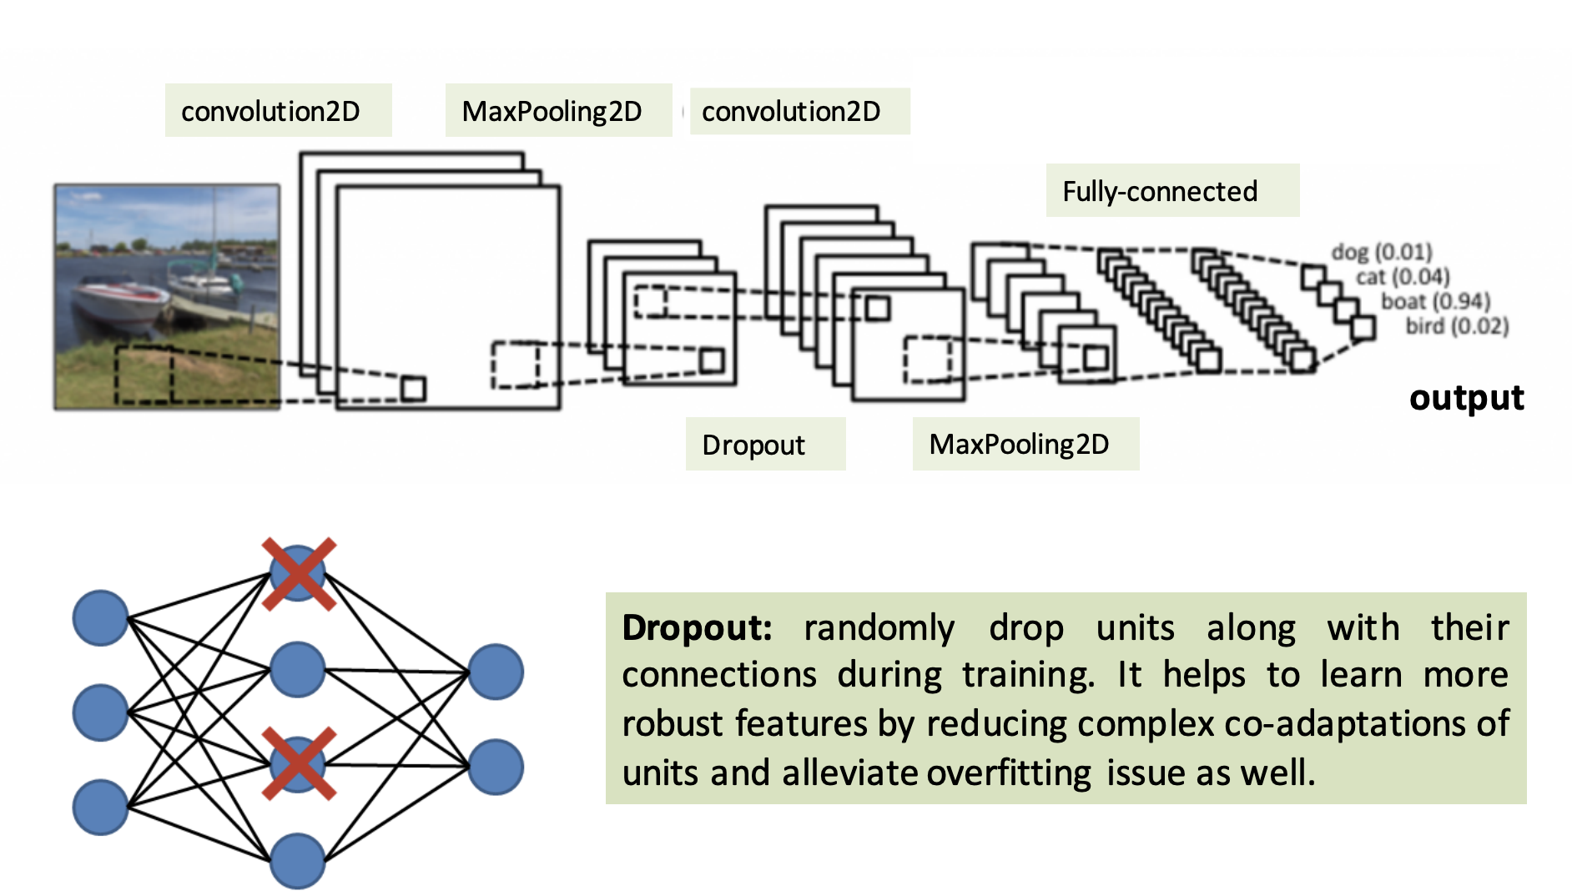

Slide 18
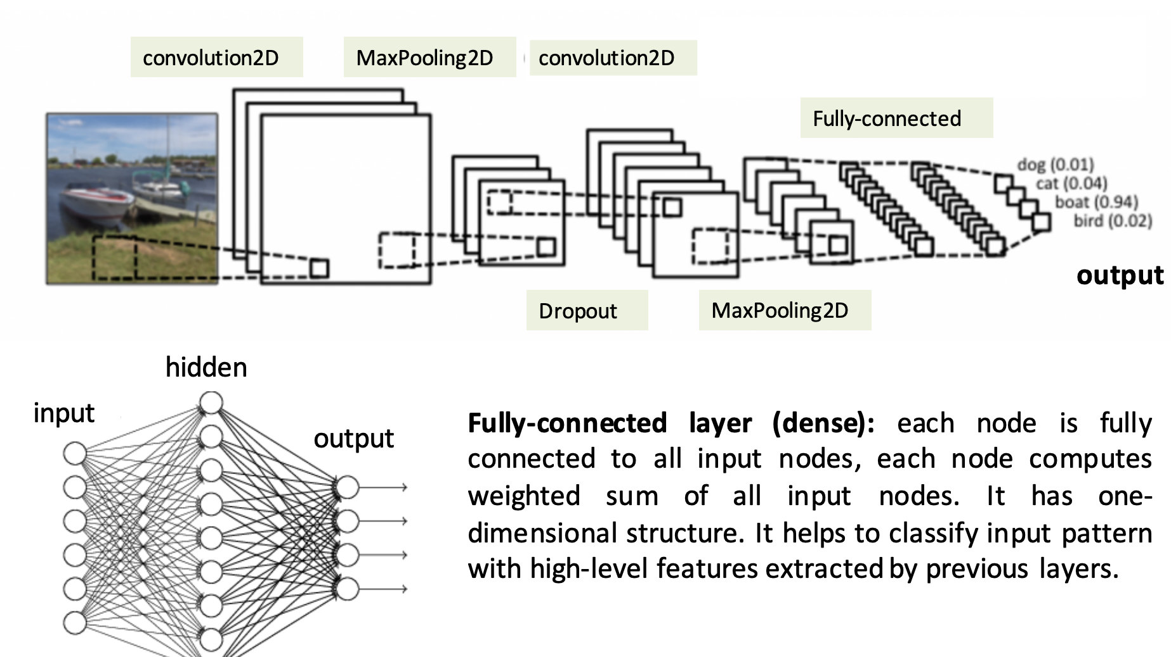

Slide 19
DL Applications
Self-Driving Cars
Voice Controlled Assistance
Automatic Image Caption Generation
Automatic Machine Translation

Slide 20
Reference
https://www.studocu.com/in/document/gl-bajaj-institute-of-technology-and-management/btech/deep-learning-ppt-full-notes/21527647
http://www.hpc.lsu.edu/training/weekly-materials/2016-Fall/machine_learning_qb2_fall_2016.pdf
https://www.webpages.uidaho.edu/vakanski/Courses/Adversarial_Machine_Learning/Fall_2021/Lecture_2_Deep_Learning_Overview.pptx

